Slide 1
2024_10_21
Dispersion at 1064nm&1550nm
Radius = 1500um
2% Unanneal/Long anneal
2x2um
For Photogalvanic, we want normal dispersion at 1064nm to avoid FWM competing power with SHG
2x2um,2%,Air Clad
THOX 15um thick

Slide 2
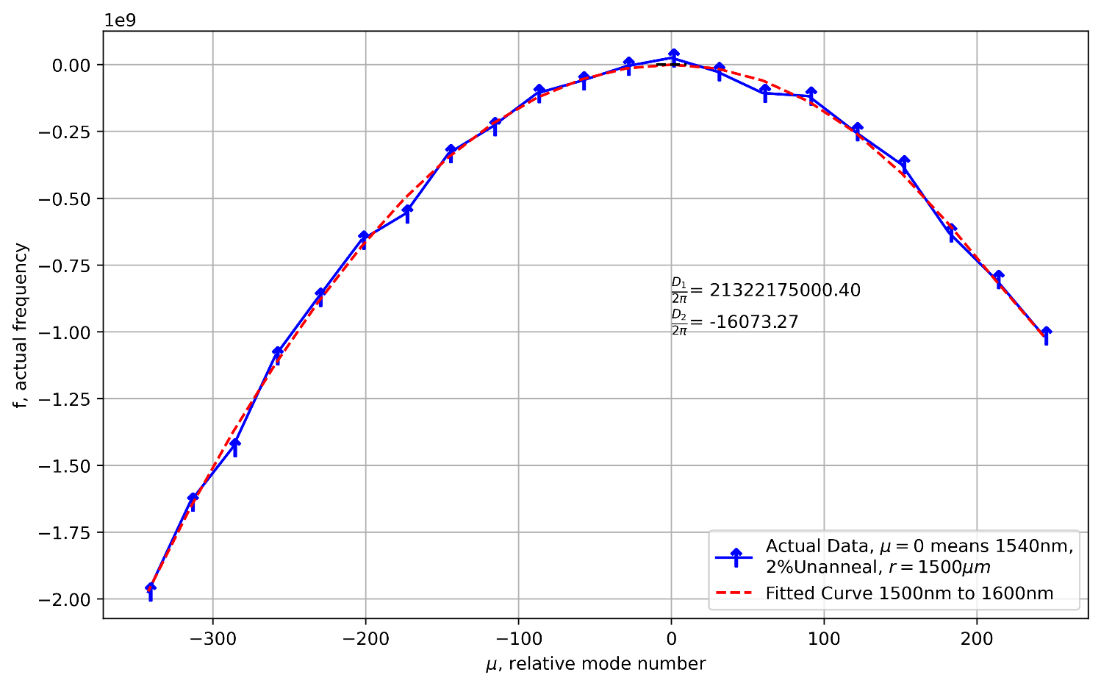
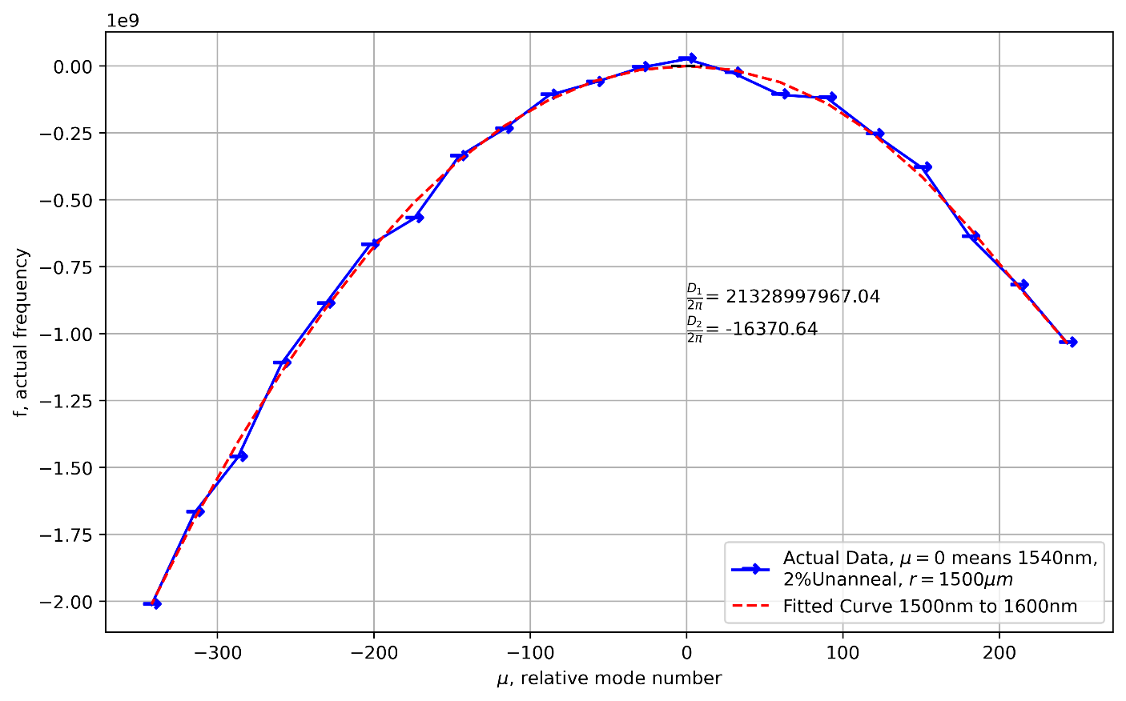
2% Unanneal, @1550nm Without fitting refractive index before simulation
These are two fundamental modes
Arrow means
E-field direction
The measured refractive index has fluctuations that cause the zigzag

Slide 3
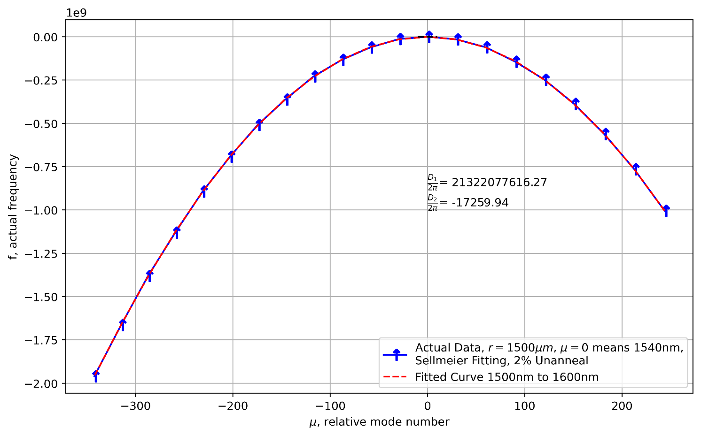

2% Unanneal, @1550nm Sellmeier fitting refractive index before simulation
Zigzag disappeared after you apply Sellmeier fitting

Slide 4
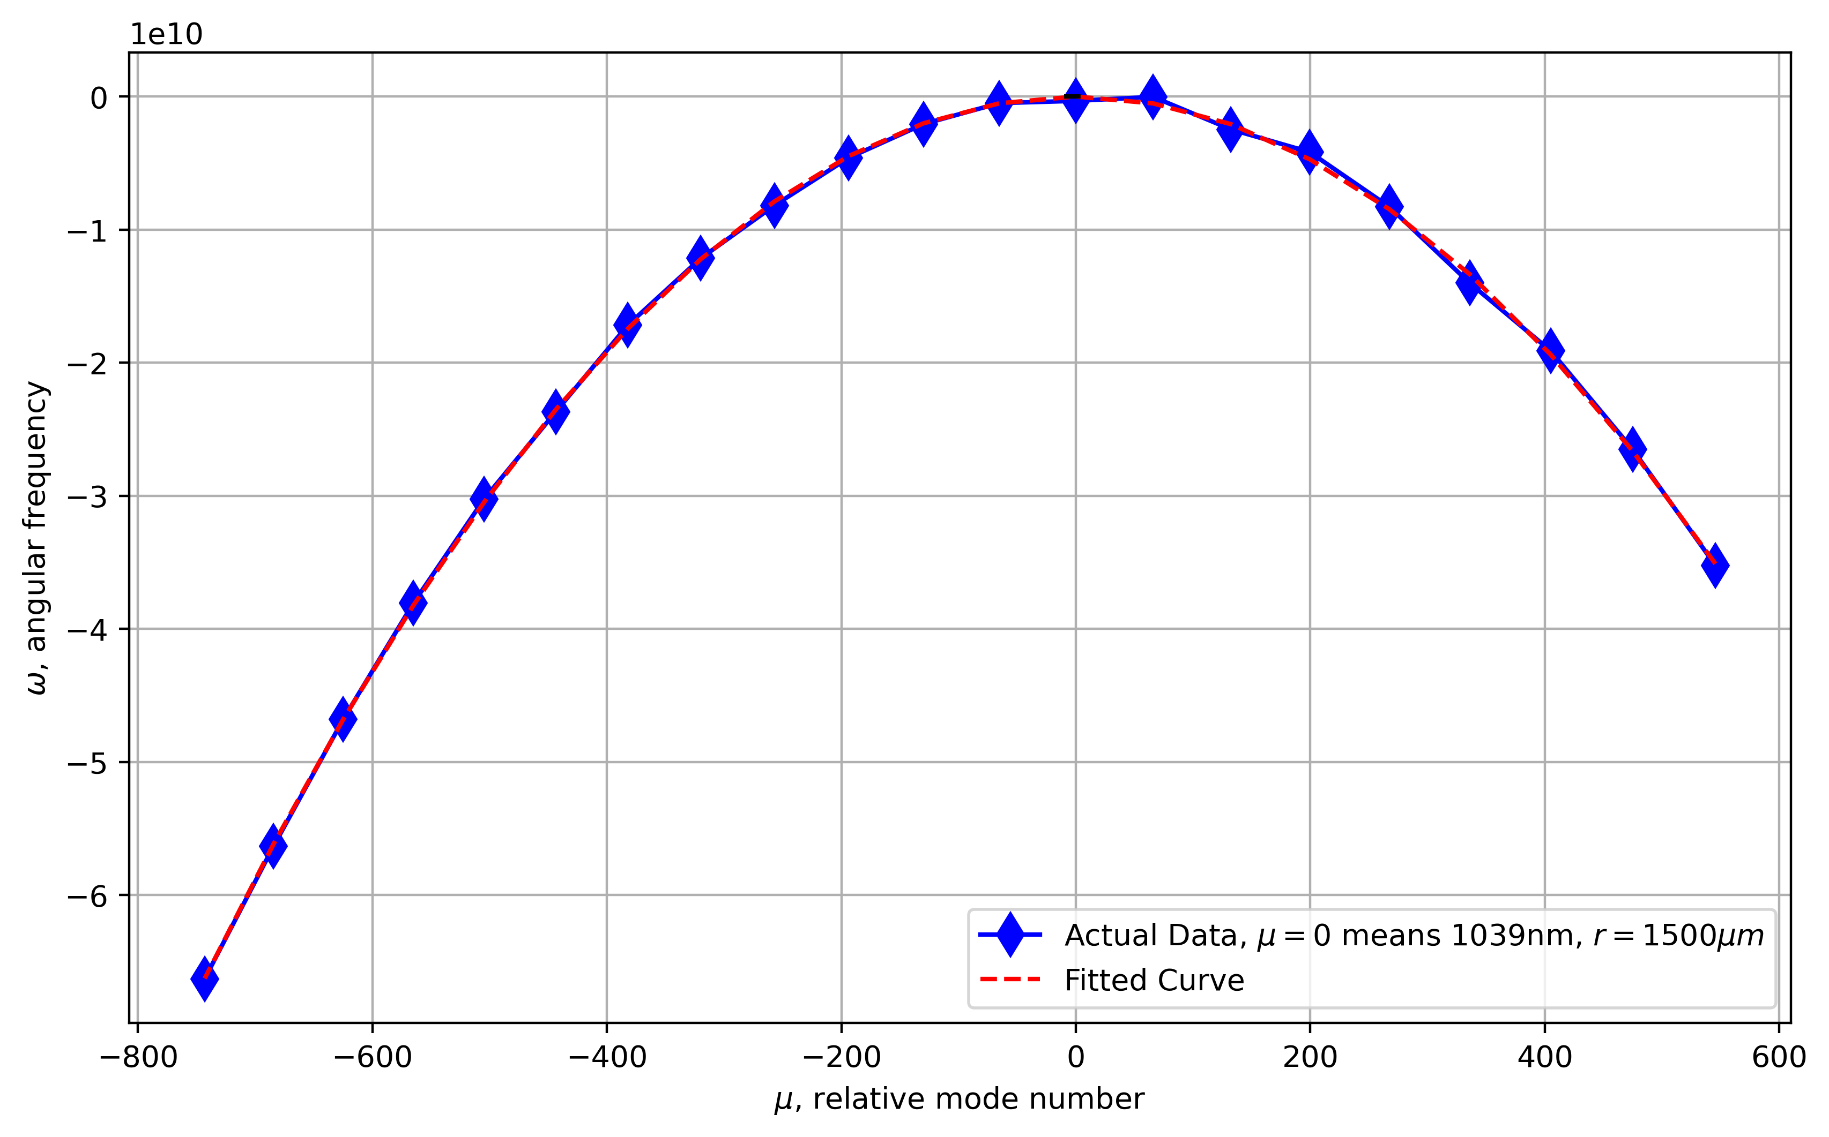
2% Long Anneal, @1064nm Without fitting

Slide 5
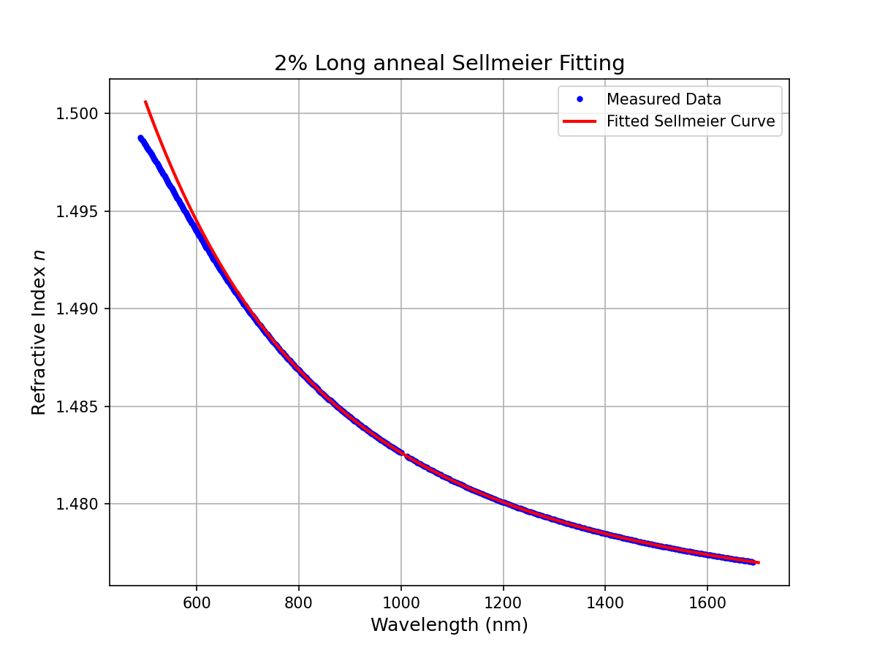
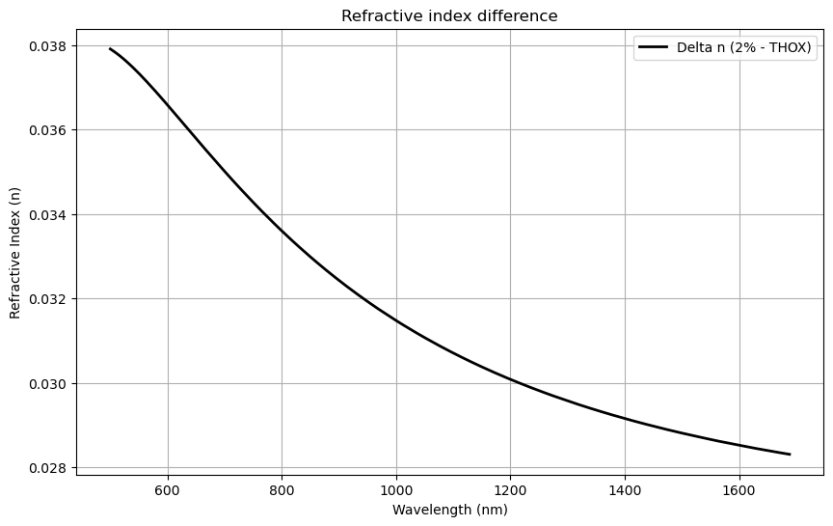
2024_10_23
Cross Section 4x12 um
Wavelength 460, 532, 780, 1060, 1550 nm
Core Material: 2% Long anneal
Radius: Whatever captures 1B Q
Subject: Bending Q
4x12,2%,Air Clad
THOX 500um thick

Slide 6
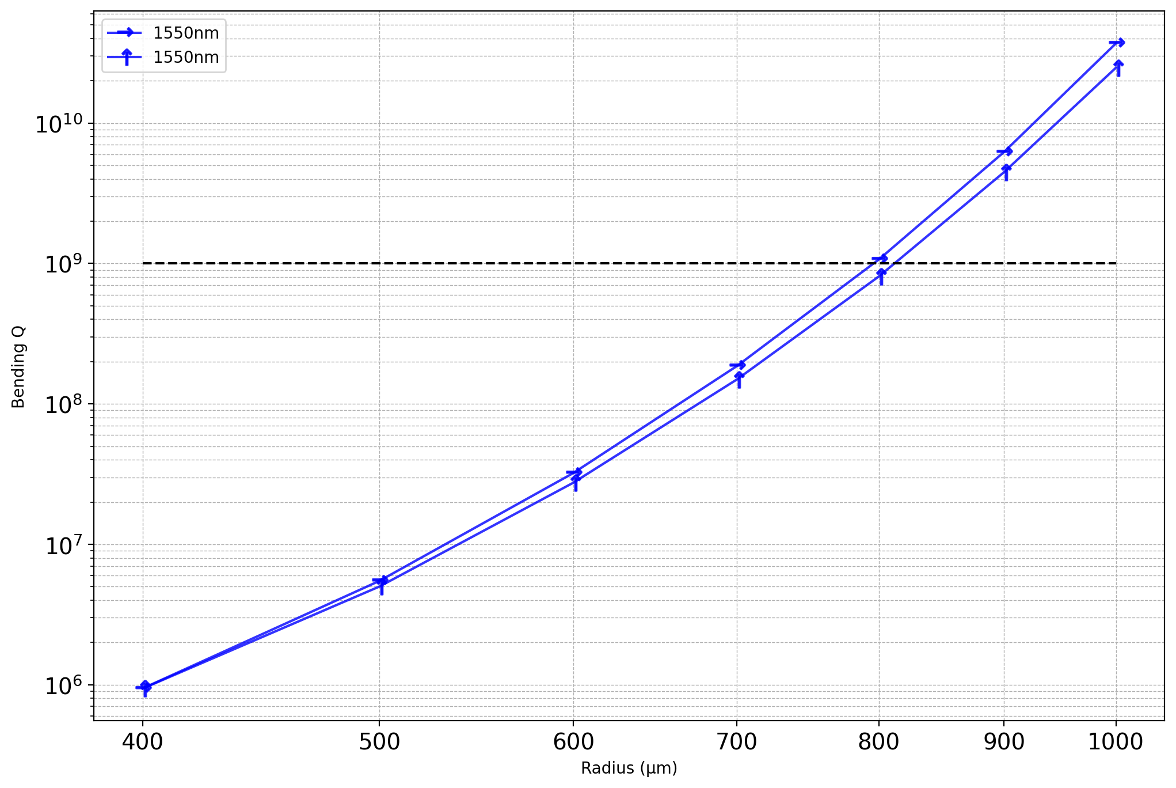
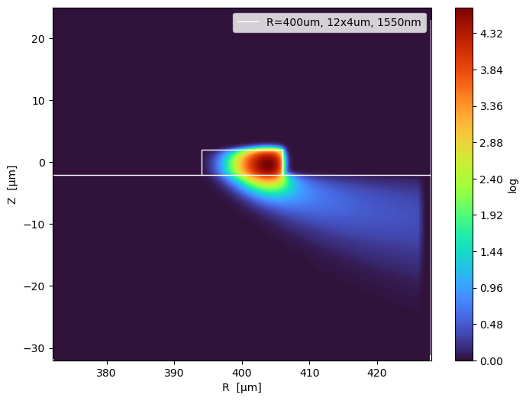
1550nm

Slide 7
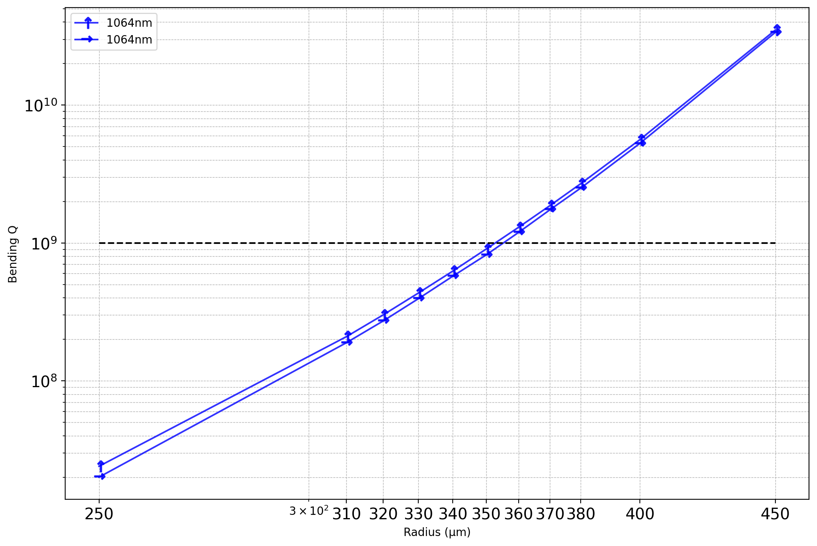
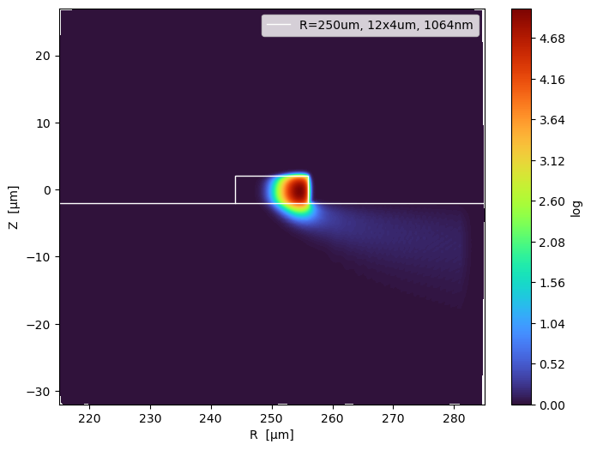
1064nm

Slide 8
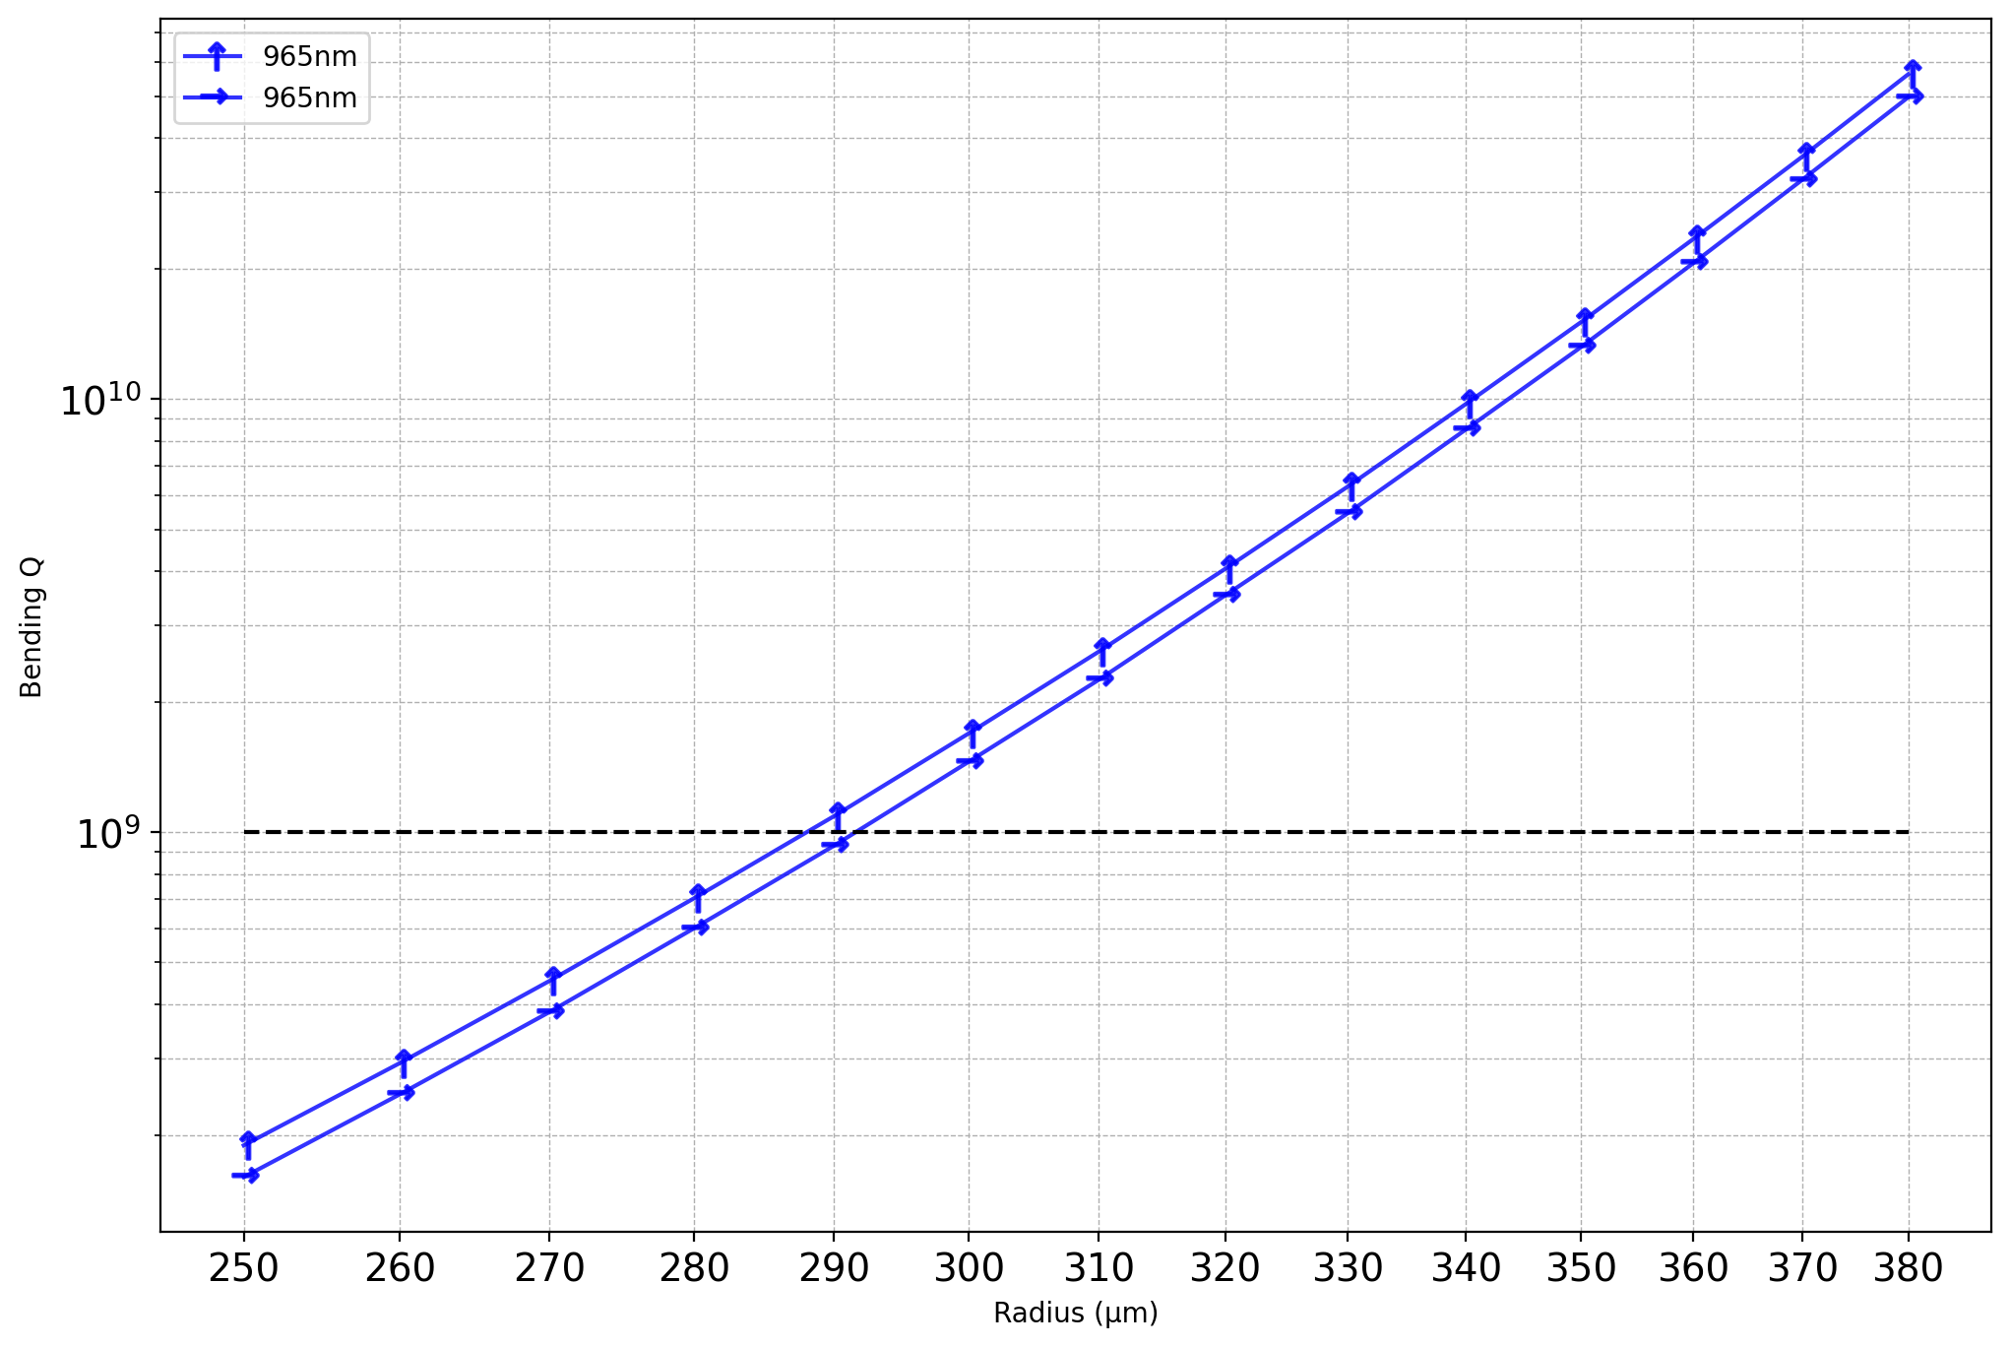
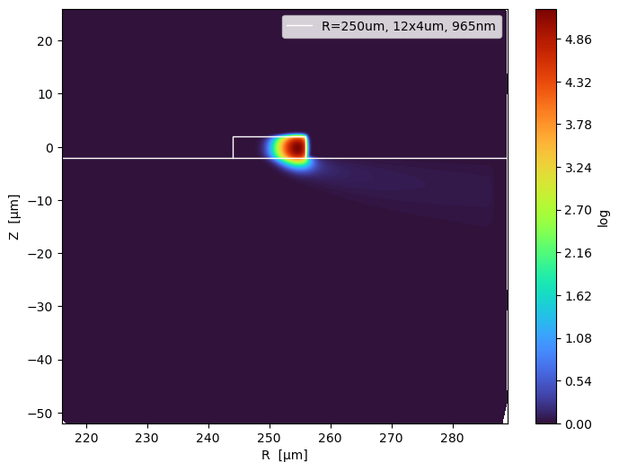
965nm

Slide 9
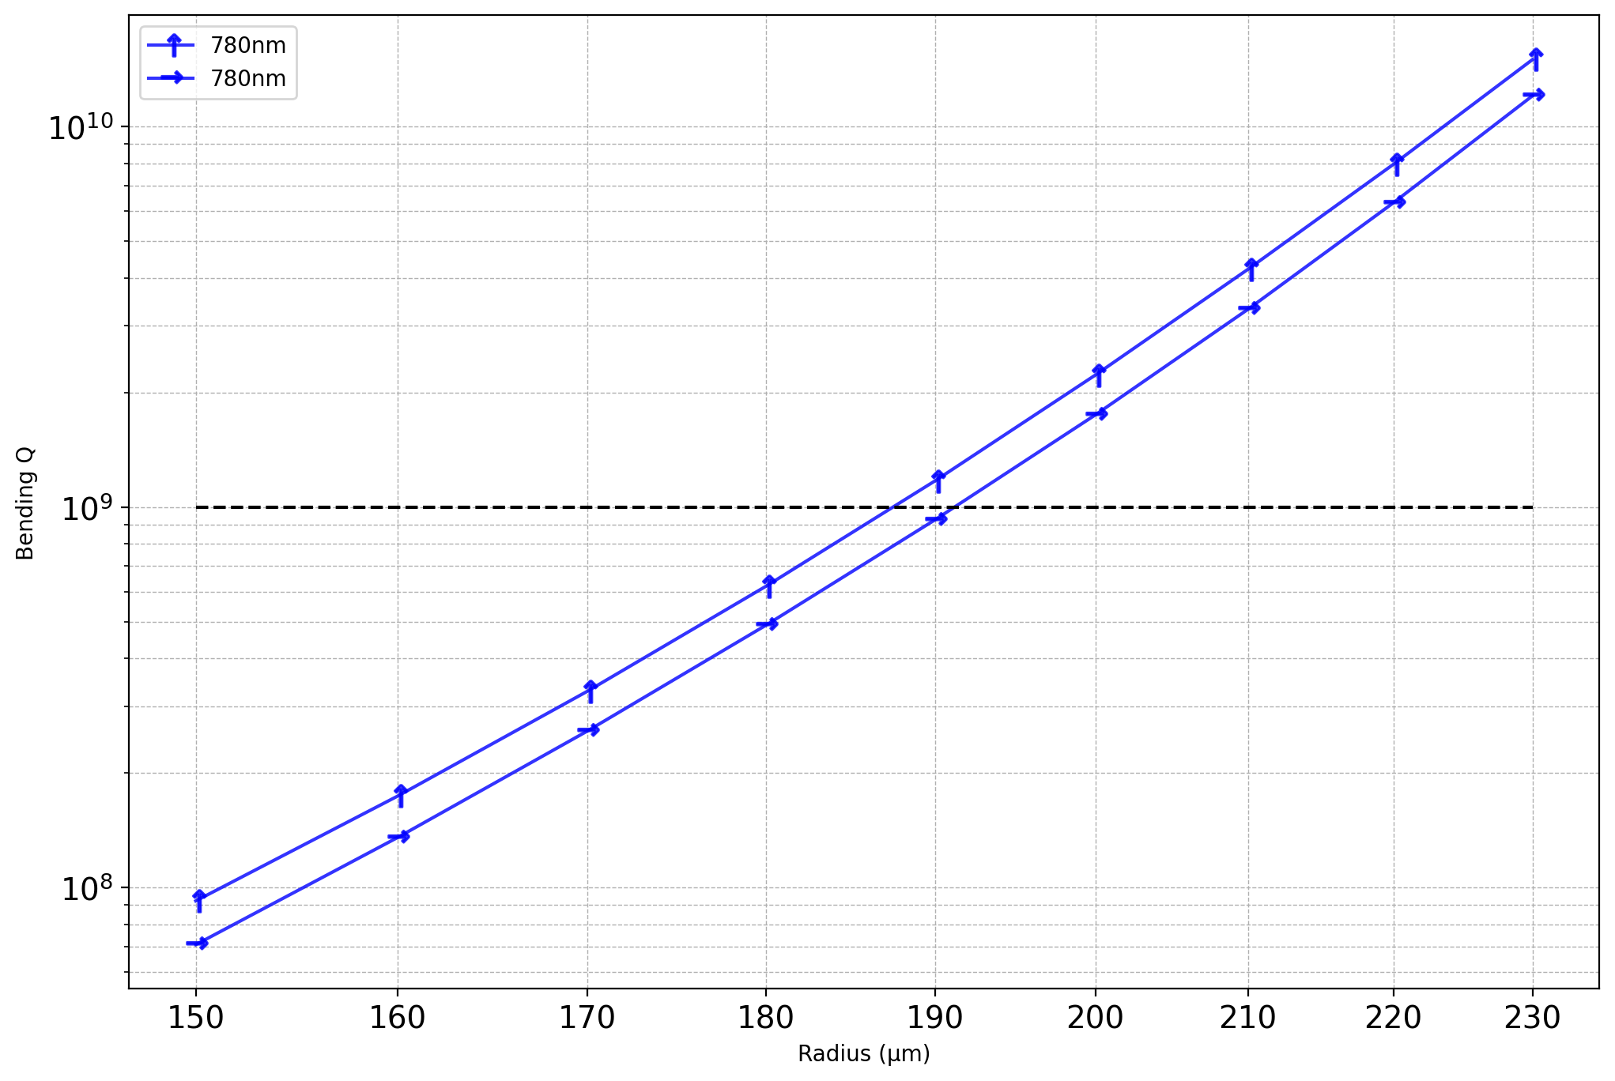
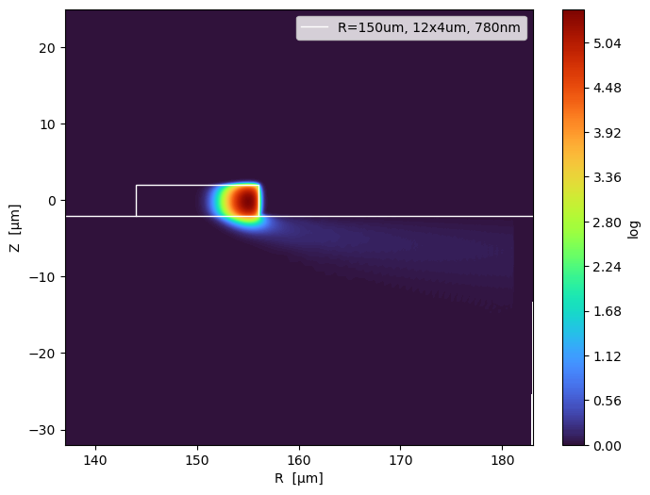
780nm

Slide 10
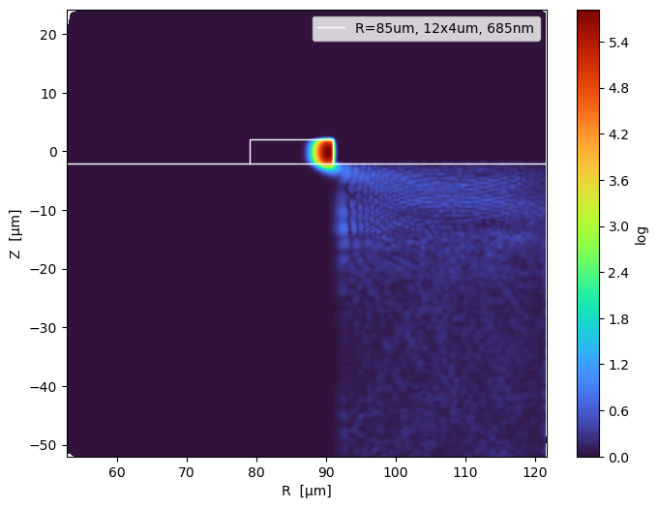
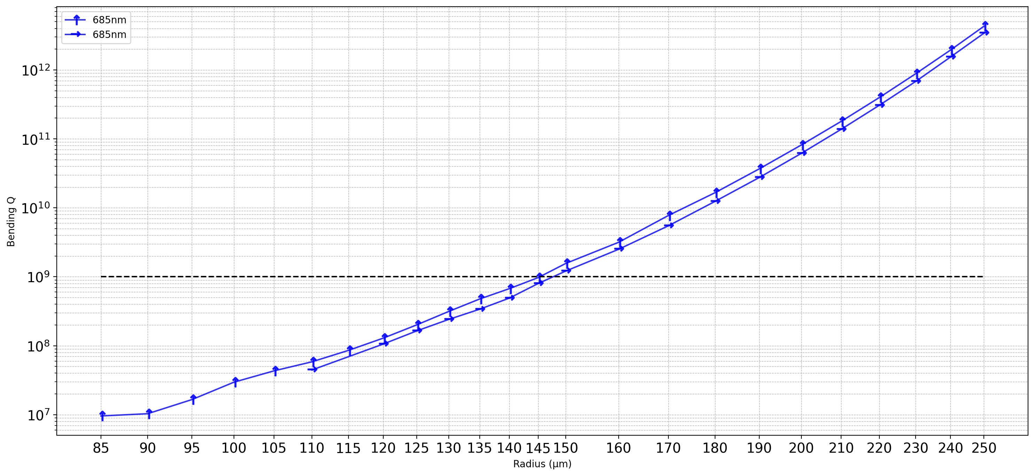
685nm
At lower radius, Comsol is more easily to find mode that is a coexistence between the core and the cladding
The blue are very faint eigenmode of the THOX

Slide 11
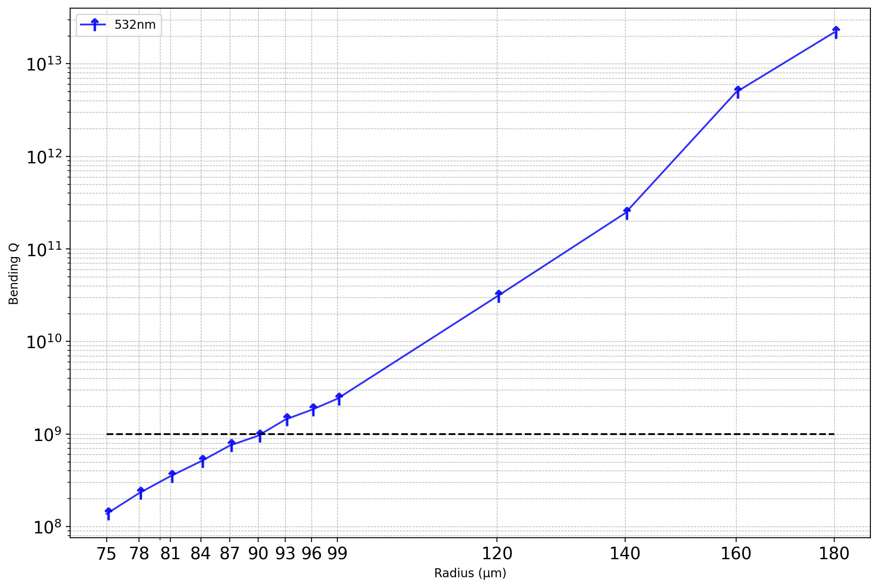
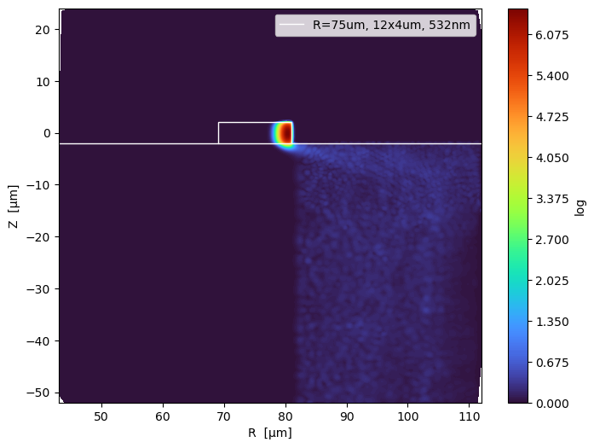
532nm
These contains the reflection(because my PML does not perfectly absorb), also the eigenmode in THOX. I believe this is mostly eigenmode in THOX, because if it is from reflection, you should see interference pattern

Slide 12
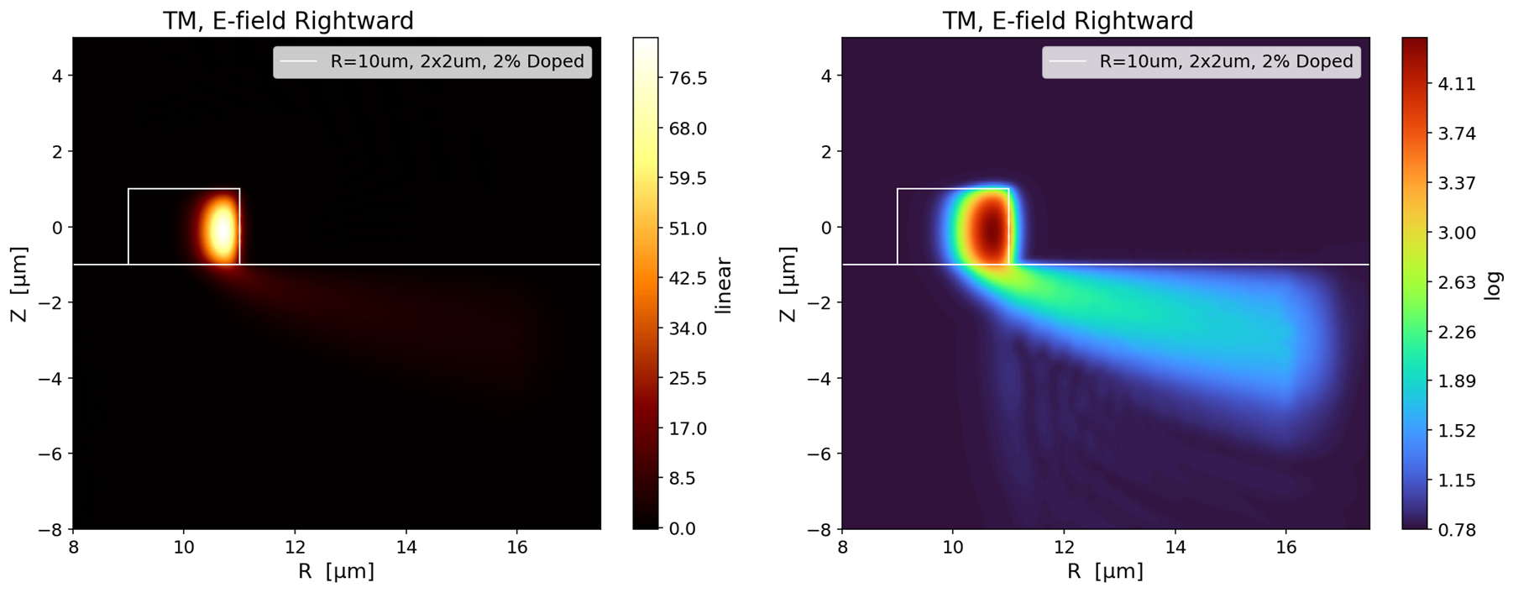
An example of reflection:

Slide 13
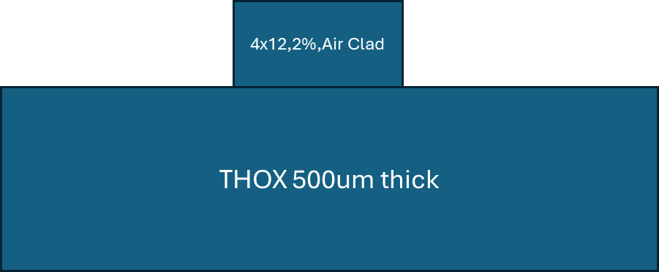
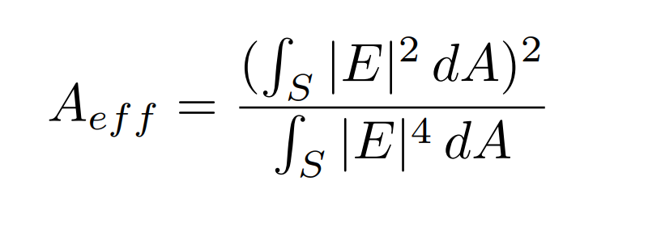
2024_10_26
Cross Section 4x12 um
Wavelength 460, 532, 780, 1060, 1550 nm
Core Material: 2% Long anneal
Radius: 1500um
Subject: Light Distribution Plot & effective mode area

Slide 14
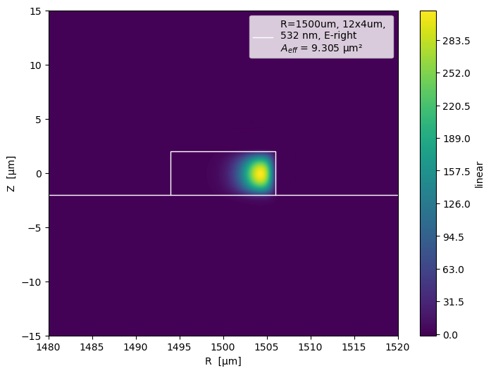
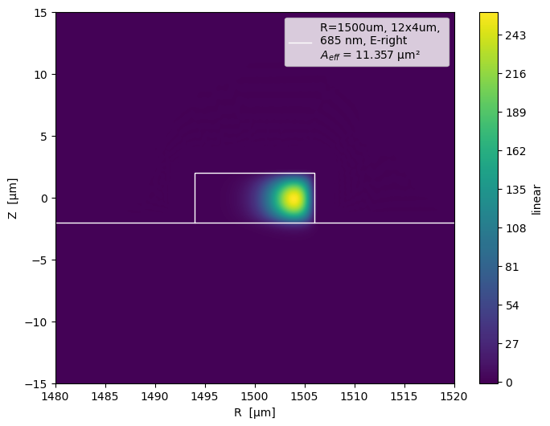

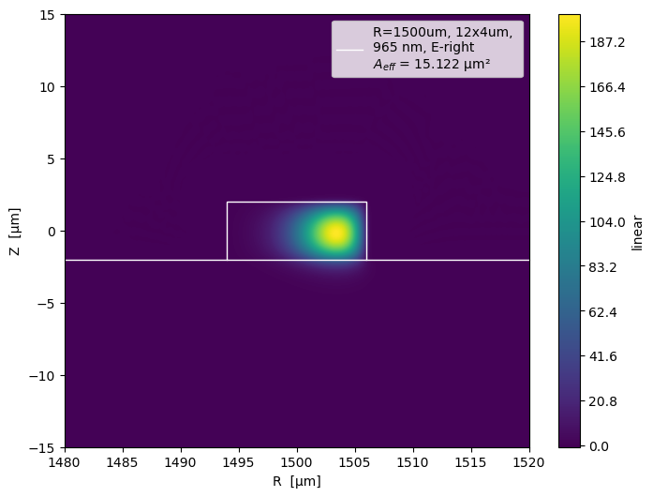

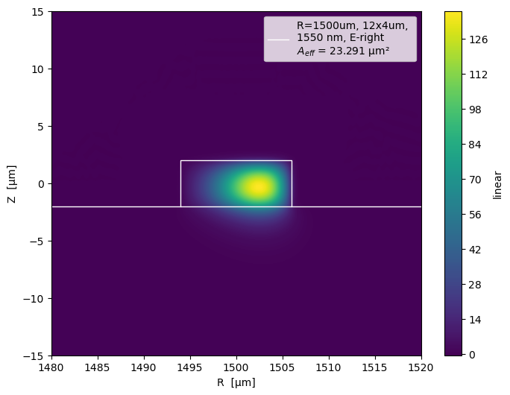
E-field to the right Linear

Slide 15
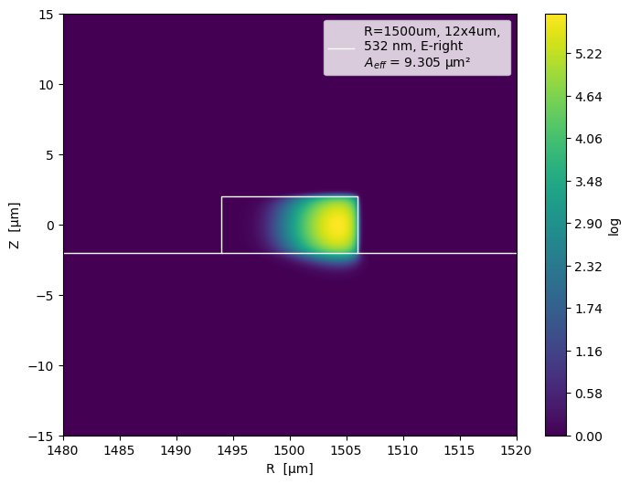
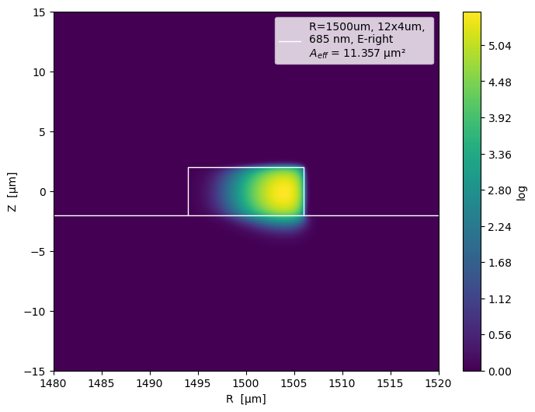

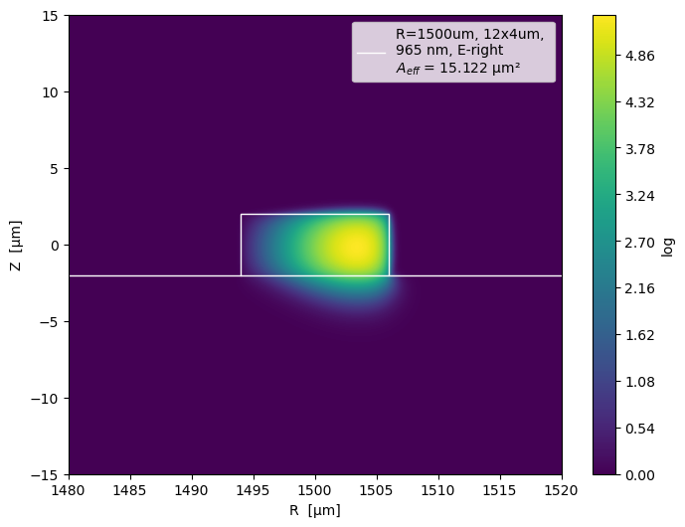
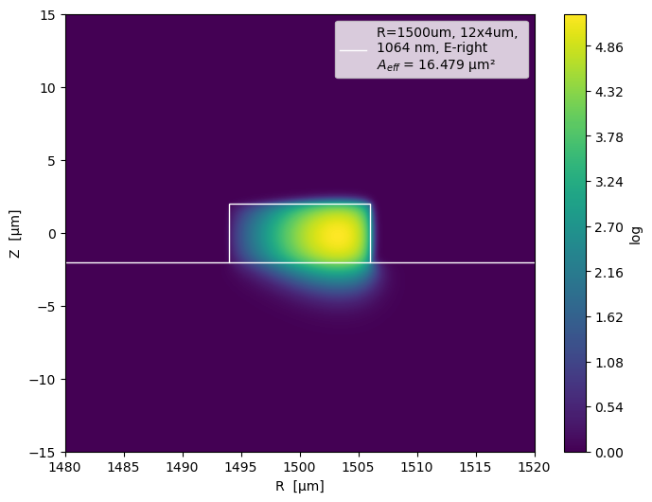
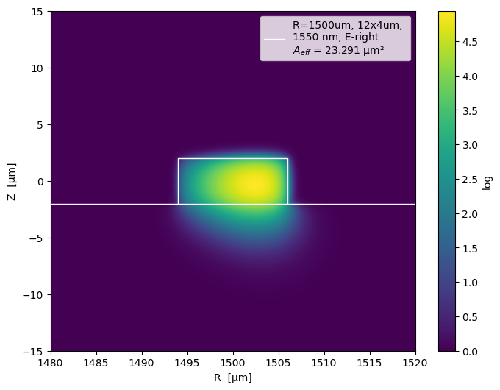
E-field to the right Log

Slide 16

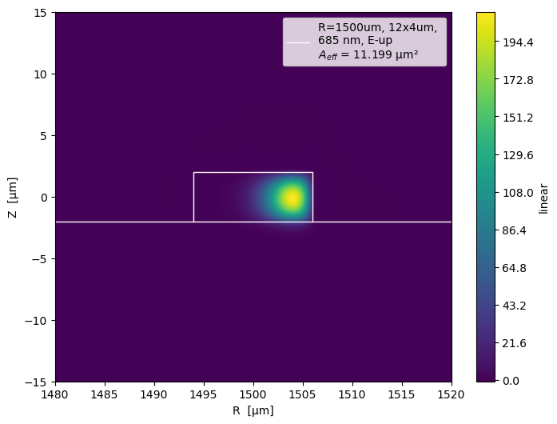




E-field Upward Linear

Slide 17



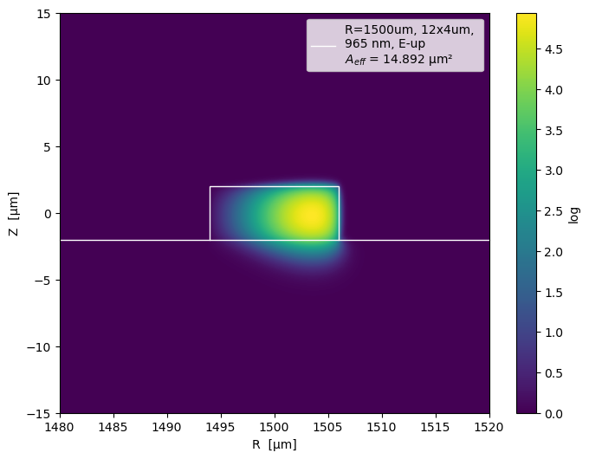
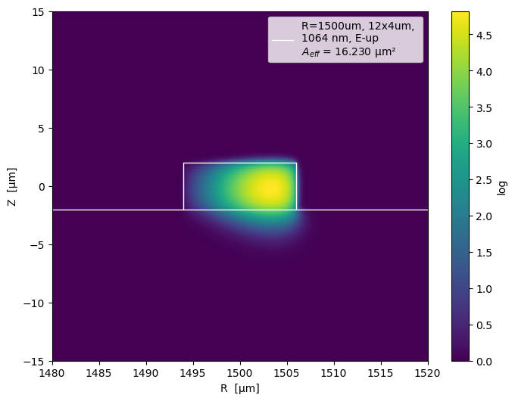
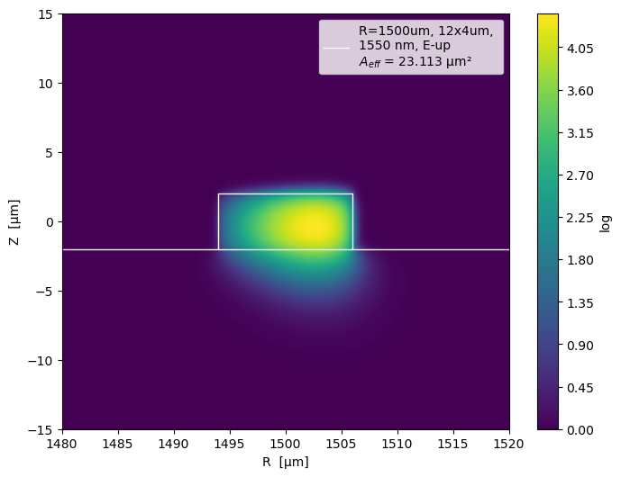
E-field Upward Log

Slide 18
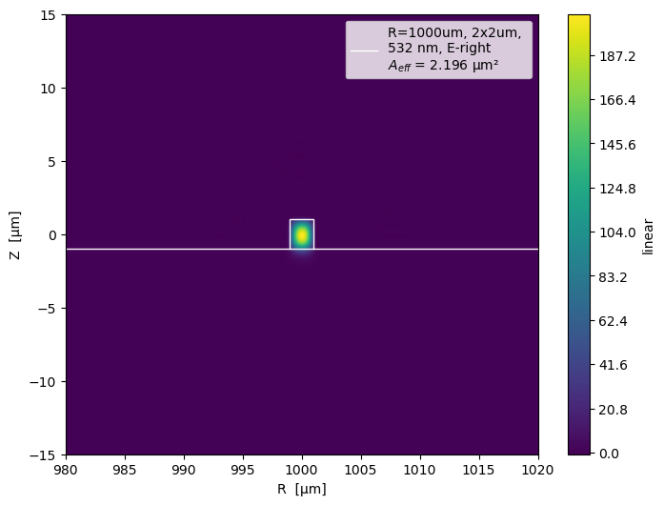
Compare: @532nm, E-Right , Linear 2x2um(r=1000um) vs. 4x12um(r=1500um)

Slide 19

Compare: @532nm, E-Right , Log 2x2um(r=1000um) vs. 4x12um(r=1500um)

Slide 20

Compare: @532nm, E-Up, Linear 2x2um(r=1000um) vs. 4x12um(r=1500um)

Slide 21

Compare: @532nm, E-Up, Log 2x2um(r=1000um) vs. 4x12um(r=1500um)

Slide 22
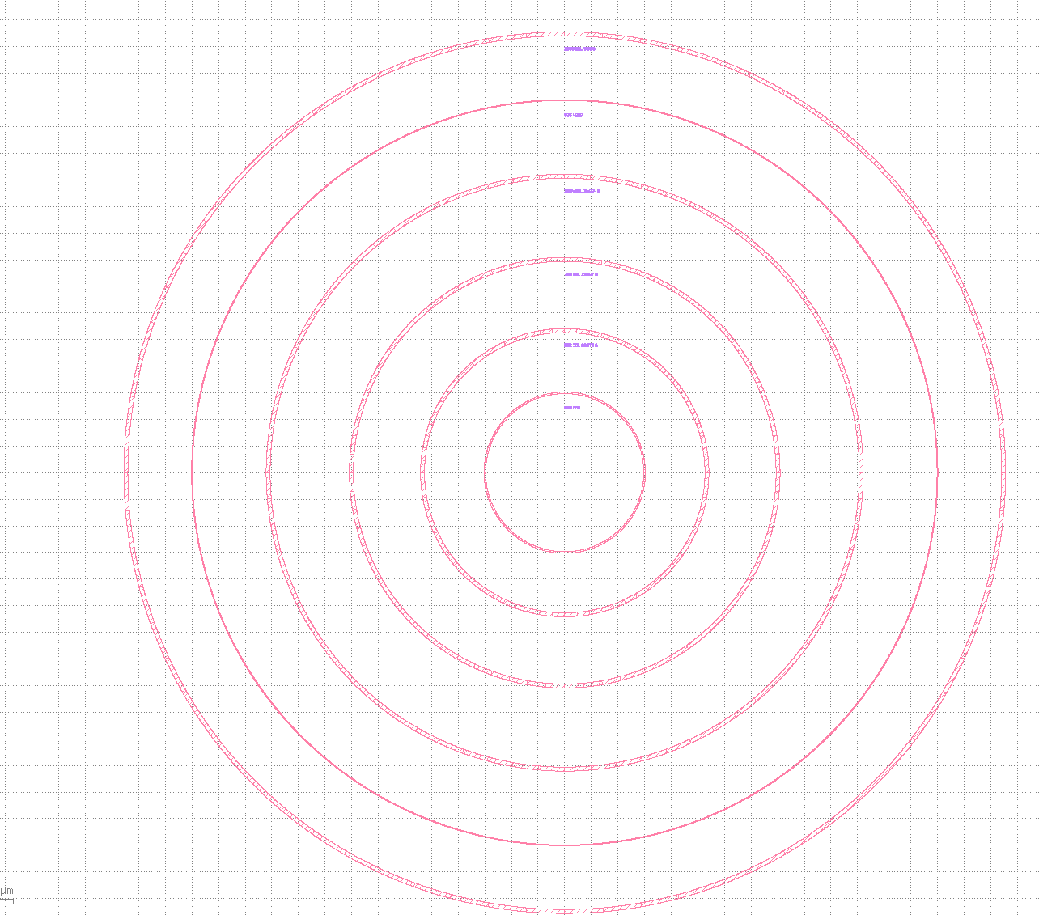
2% Long Anneal
30 x 2um
@1550nm
OR1: R=3300um
OR1.5: R=2800um(6um width)
OR2: R=2250um
OR3: R=1600um
OR4: R=1050um
OR1
OR1.5
OR2
OR3
OR4
E up: Q = 0.283M
E right: Q = 2.12M

Slide 23
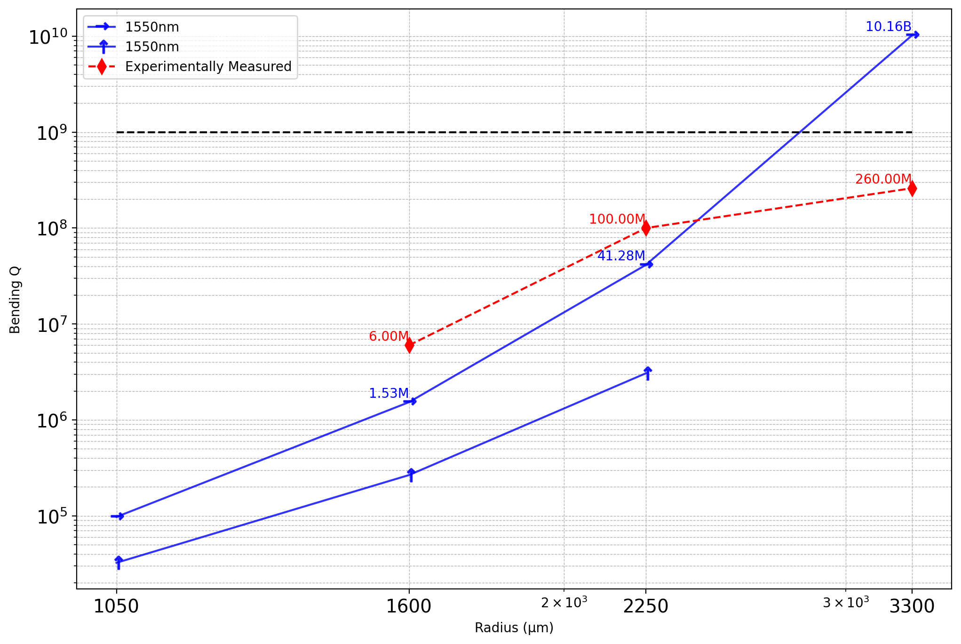
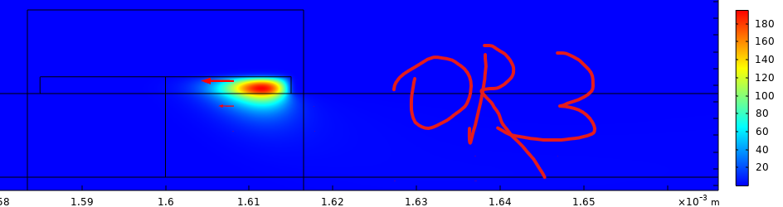
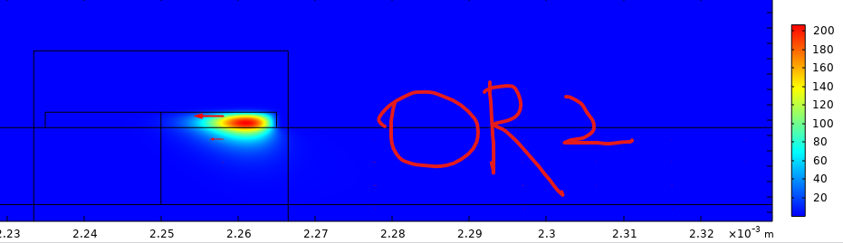
2% Long Anneal
30 x 2um
@1550nm
OR1: R=3300um
OR2: R=2250um
OR3: R=1600um
OR4: R=1050um
Aeff = 19.439836253579607 um^2
Aeff=21.446663810347093 um^2
OR4
OR3
OR2
OR1

Slide 24
780nm 3x2 clad and non clad r=1000um
No Cladding, 780,
E right: Simulation Fluctuates a lot at the order of 10^20 Q. The bending Q should be very high
E up: B
Yes Cladding, 780,
E right: Still very high ~10^19
E up:

Slide 25
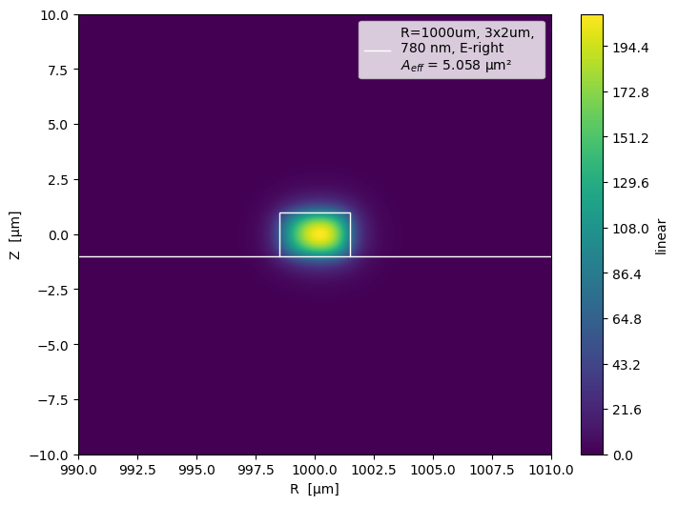
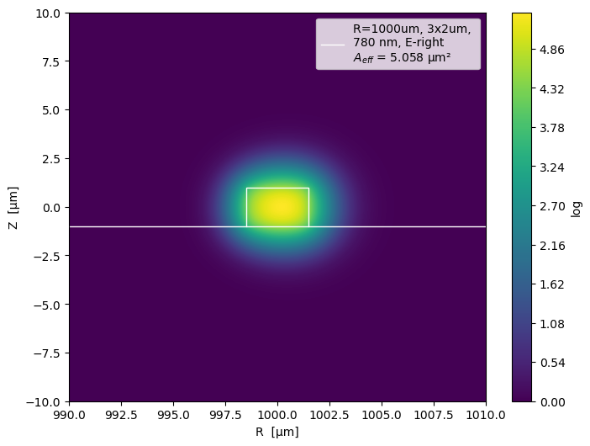
Cladding Device, 780, up and right have almost identical mode area so I only show one of them

Slide 26

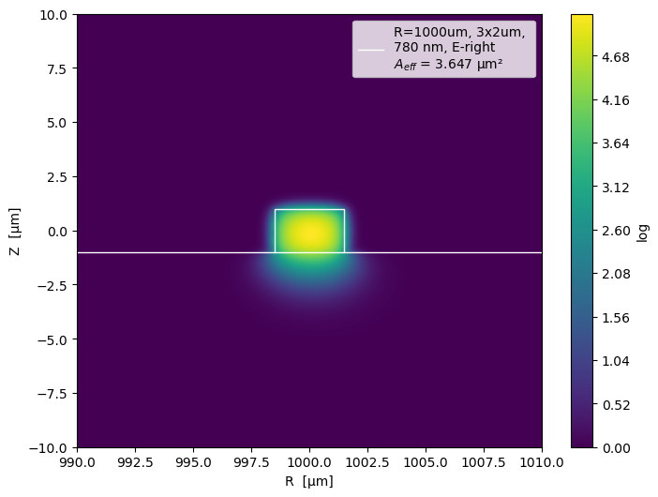


Air Cladding, Up and Right E-field have slightly different mode distribution

Slide 27
2024_10_29
3x2 um, 780nm, air clad dispersion
2x2um, 532nm, air clad, dispersion, r=1000um

Slide 28
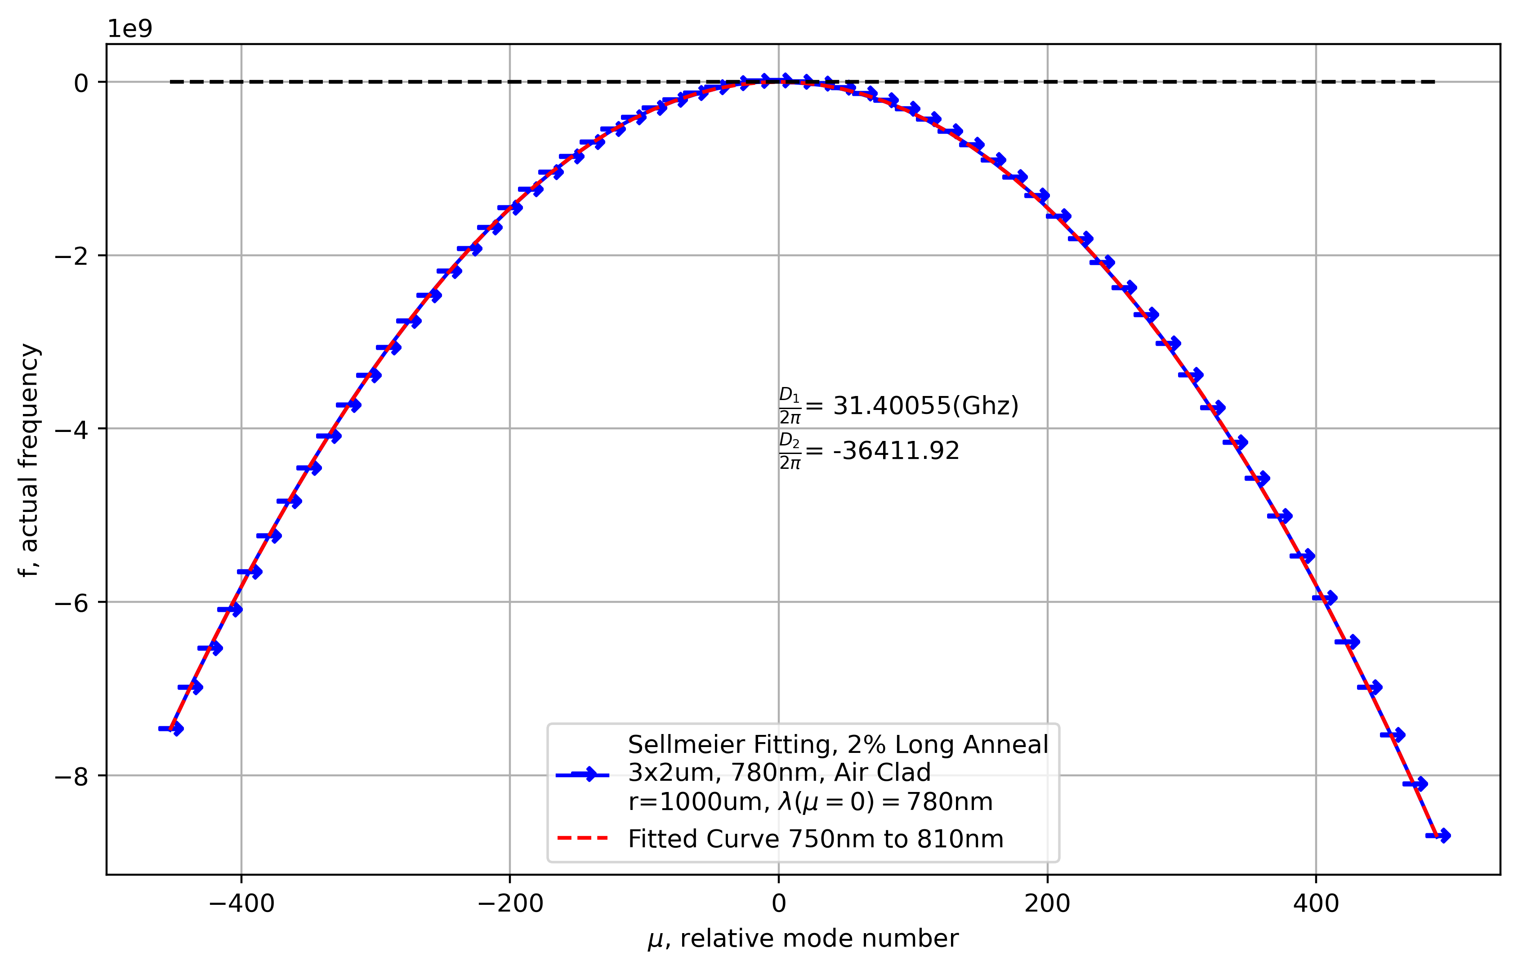
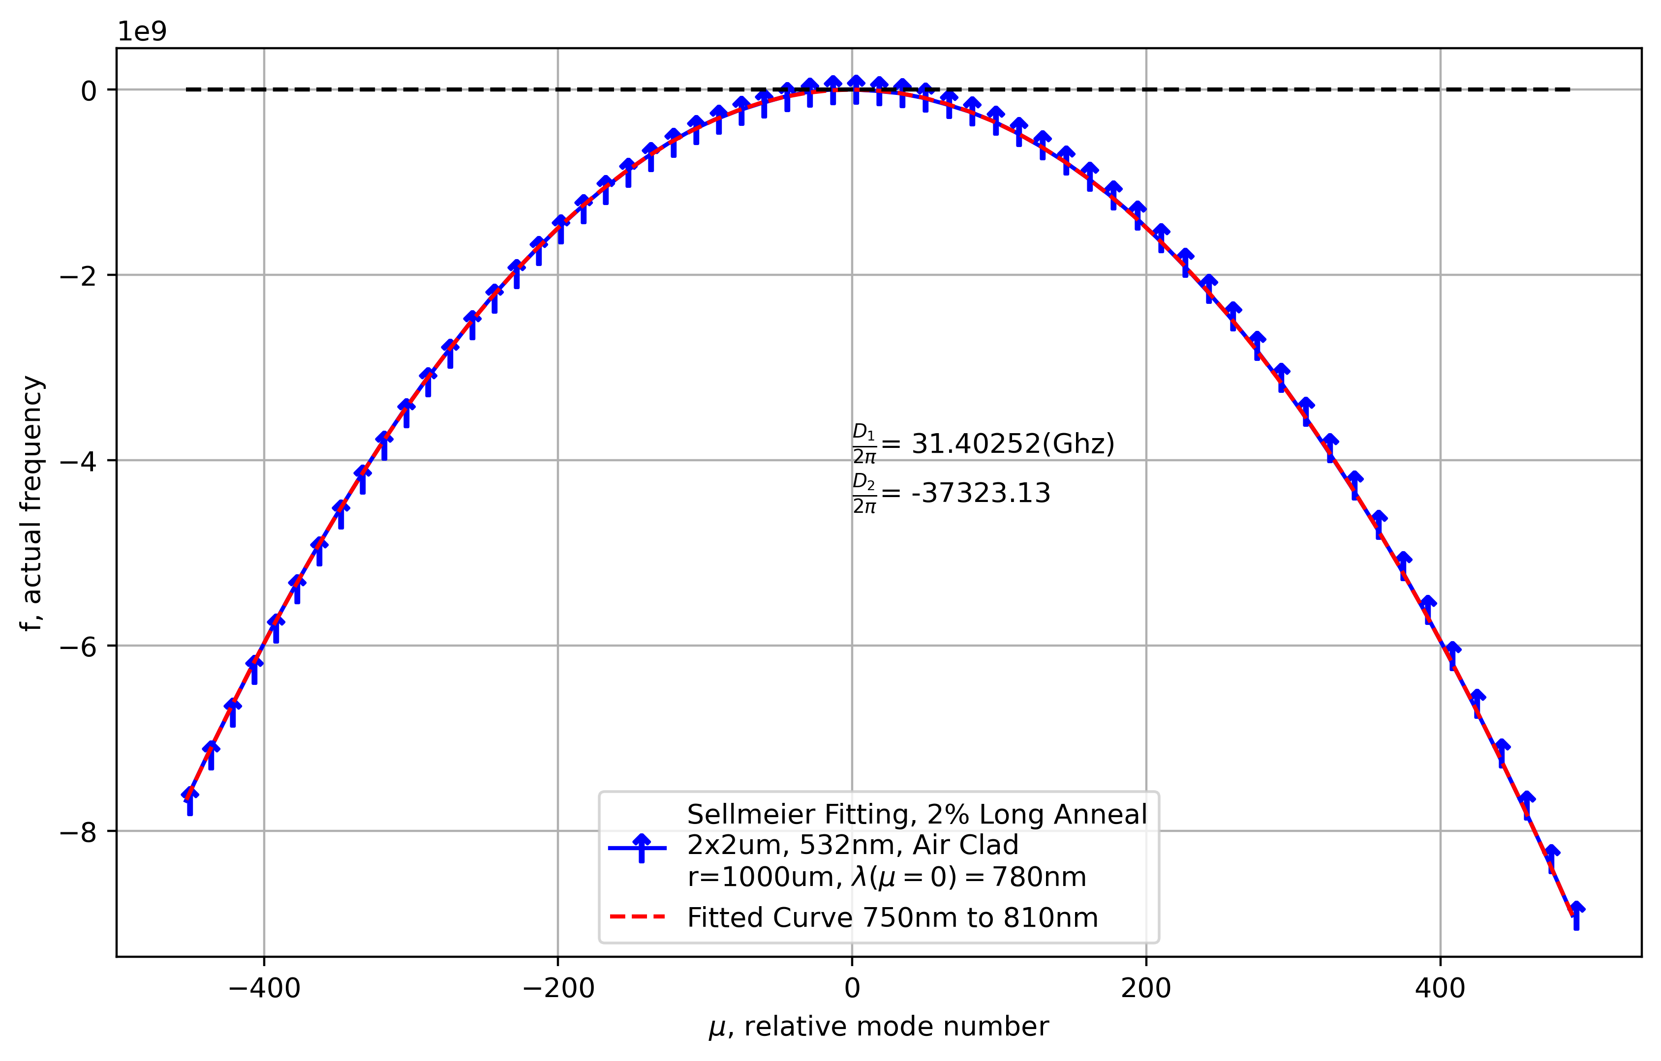
3x2 um, 780nm, air clad dispersion

Slide 29
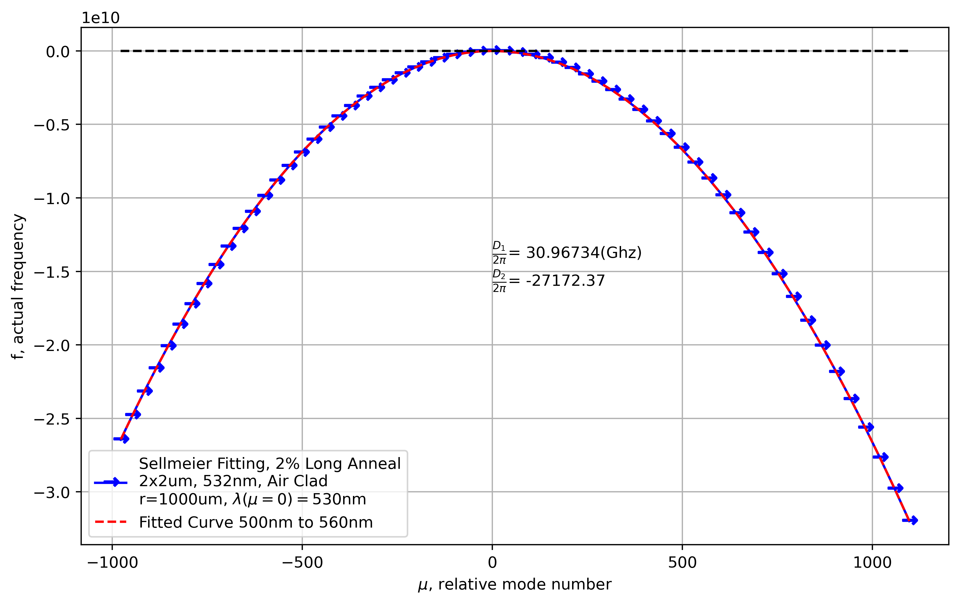
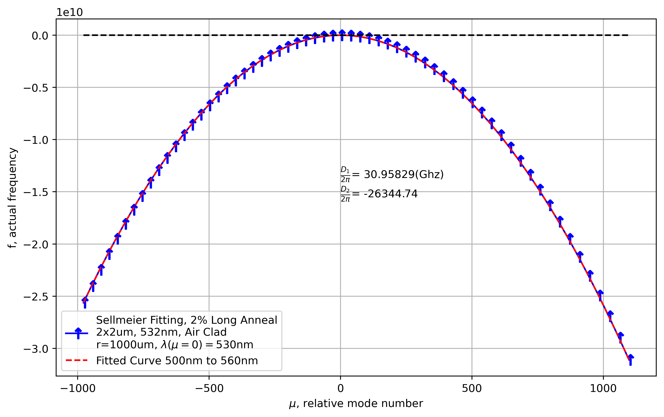
2x2um, 532nm, air clad, dispersion, r=1000um

Slide 30
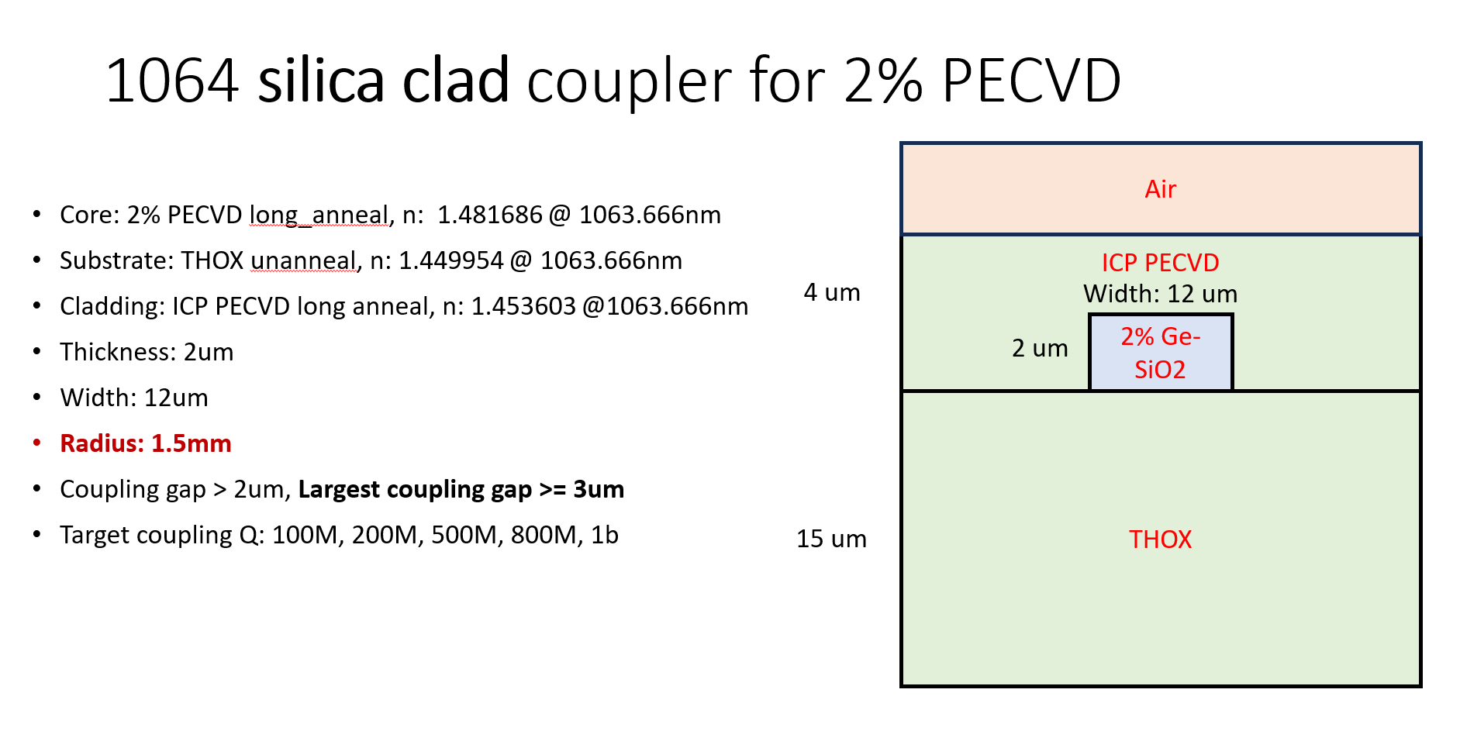
2024_11_3
Radius V.s. momentum
Width v.s. momentum
2x12um, R=1500um
ICP-PECVD cladding
2% long anneal

Slide 31
Steps
Get the FSR
Based on the coupling Q, calculate the target kappa
Based on the target kappa, tune the geometry for covalent bond formation

Slide 32
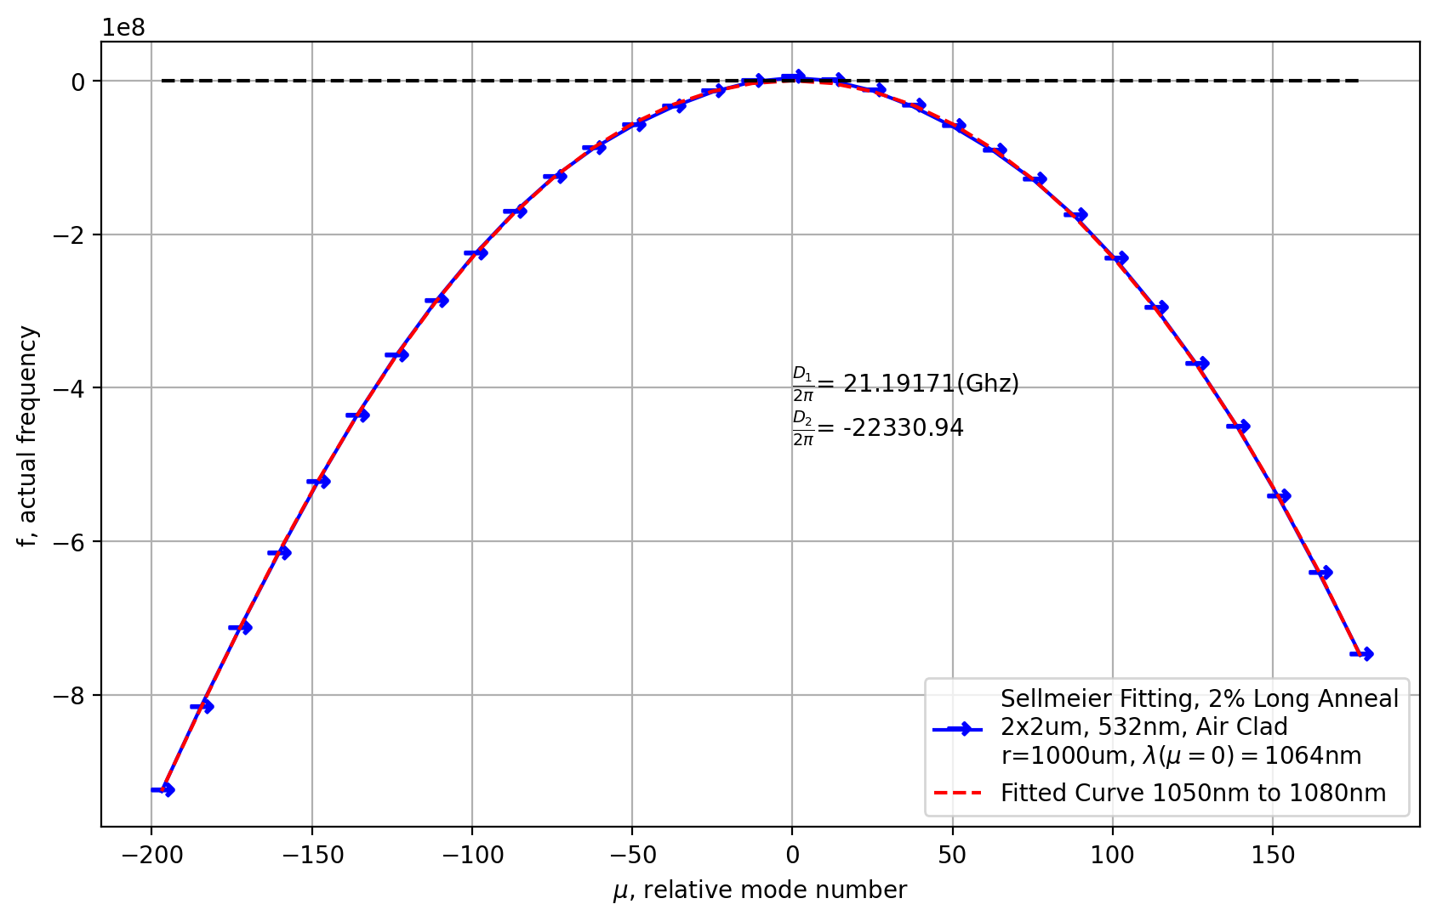
Get the FSR
21.19171390008956 right
21.187508667145355 up

Slide 33
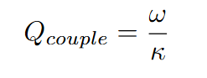
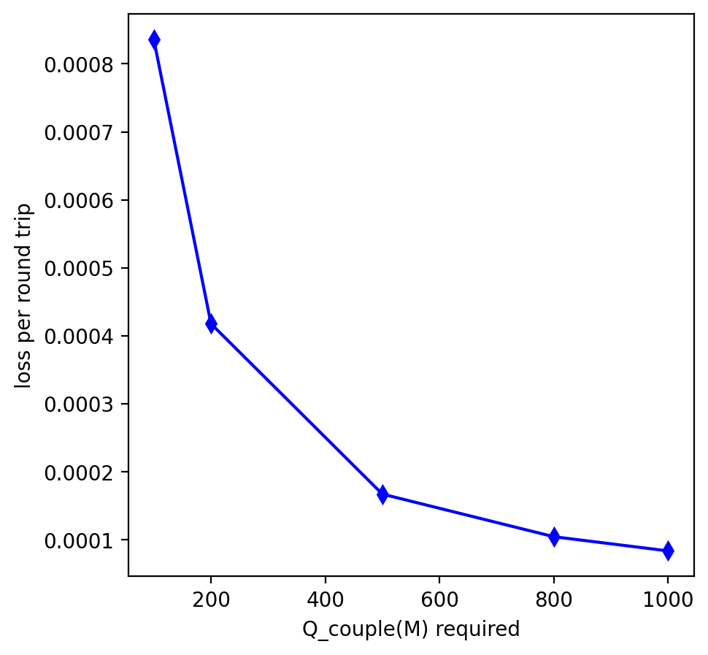

Based on Coupling Q
Lower width, stronger momentum
Larger radius, stronger momentum(might be incorrect)

Slide 34


Momentum and width
Thus, try:
Gap = 3.2um, 2x2um
0.002211083304213684
1.15069203e-07

Slide 35


Momentum and Gap Size

Slide 36





Test FUck
Bad configuration choice
Gap = 3.2um
2x2 um
帮!
Problem
When momentum is not conserved, I still find some mode, but are they coupled?
I will get an imaginary beta21, what does it mean?
Problem
Under sqrt is negative
Beta21 = 2*delta_beta

Slide 37






Test Fuck 2
Gap = 3.37um
2x2 um
Warren Jin’s Paper about SiN
帮!
Also I noticed that including or excluding PLM, the energy profile and beta are not the same
帮!
The energy profile tendency(from left to right is 1060,1064,1068).
Not the same as the paper(but I think it is normal)

Slide 38



Based on Test Fuck2, get the couple Q
Loss per round trip
My simulation tells me:
FSR=21.19171390008956Ghz for E-right
Beta_21 = 0.2455595259210124
delta_beta = 0.013914358123656712

Slide 39

Third Try
Gap =4um
1.9um width

Slide 40


Gap=4um
1.882um --- beta21
Change width, delta beta
Very hard to match momentum, skip gap =4

Slide 41





Gap = 3.6um, still sensitive, but ok

Slide 42


Δβ is 0.005386158311011968
|β_21| is 0.18904083071175182
Δβ / |β_21| = 0.028492036829994394

Slide 43

Gap=4.5um

Slide 44
Is beta 21 sensitive to waveguide width +-1nm?

Slide 45
Difficulty: find beta21 that is small
Find momentum conservation(width, gap)

Slide 46

11/12 Spherical Resonators
10um
1064
Infinitely high bending Q

Slide 47
Hunting for anomalous dispersion
532, 780,1064
2um thick(except for 1550n, that’s 4um)
Diameter = 2mm/3mm
Fundamental modes(Need to test higher modes as well)
Could be air or silica cladding

Slide 48




532 air clad r=1500um no fitting, 2%

Slide 49




532 air clad r=1500um fitting, 2%

Slide 50


Radius = 1000um, 2um height, 1um width

Slide 51


2024/12/09
Sphere
2% as core
Air Clad

Slide 52




980

Slide 53





2025/1/25
Best: z=8um
Best: z=8um.
2x10um PECVD Clad.@520nm
Laser Diode is modelled as elliptical gaussian
Divergence angle: x = 22deg, y=8deg

Slide 54


Long Z case

